Slide 1
Praveen .G
421221104028
Final Project
3/21/2024 Annual Review

Slide 2
PROJECT TITLE
Human Activity Recognition With Convolutional Neural Network (CNN)
3/21/2024 Annual Review

Slide 3


AGENDA
Introduction
Problem Statement
Project Overview
End Users
Solution and Value proposition
The WOW in Your Solution
Modelling
Result
Conclusion
3/21/2024 Annual Review

Slide 4

PROBLEM STATEMENT
Develop a CNN-based program for accurate real-time human activity recognition from wearable sensor or video data, catering to applications like healthcare monitoring and security surveillance.
3/21/2024 Annual Review

Slide 5

PROJECT OVERVIEW
Overview:
Goal : Develop CNN-based program for real-time Human Activity Recognition.
Components :Data Collection ,CNN Model Design ,Model Development.
Dataset: Diverse labeled datasets ,Training ,Validation ,and Testing Datasets.
Methodology:
Data Collection and Processing.
CNN Model Training and Evaluation
Model Architecture Design
Real Time Implementation and Deployment
3/21/2024 Annual Review

Slide 6

WHO ARE THE END USERS?
End Users:
HealthCare Providers and Researchers.
Rehabilitation Center and Elderly Care Facilities
Potential Use Cases:
Tracking patients' physical activities for assessing their health status.
Detecting suspicious activities in real-time and alerting security personnel.
Detecting dangerous actions or conditions in workplaces to prevent accidents
3/21/2024 Annual Review

Slide 7

YOUR SOLUTION AND ITS VALUE PROPOSITION
Solution:
Developed a CNN for Real time Human Activity Recognition.
Value Proposition:
Minimizing accidents through prompt detection and intervention.
Proactively addressing hazards to prevent costly incidents.
Fostering a safer environment for higher morale and productivity.
3/21/2024 Annual Review

Slide 8

THE WOW IN YOUR SOLUTION
WOW Factor:
improve safety protocols and adapt to changing workplace dynamics.
Implementing augmented reality (AR) or virtual reality (VR) simulations
Integrating IoT-enabled smart equipment and machinery to communicate safety alerts
3/21/2024 Annual Review

Slide 9
MODELLING
CNN Architecture:
Basic CNN
Inception Network Model
Attention-based Models
Dataset:
Diverse labeled datasets .
Training ,Validation ,and Testing Datasets.
3/21/2024 Annual Review

Slide 10
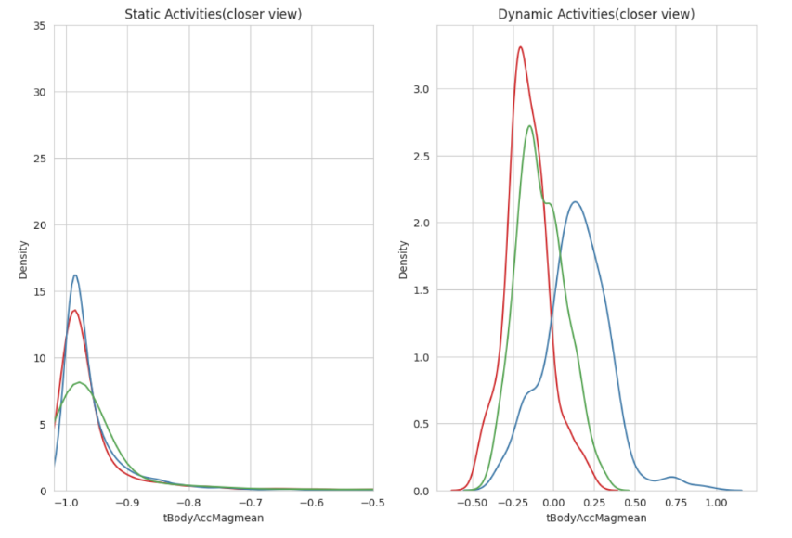
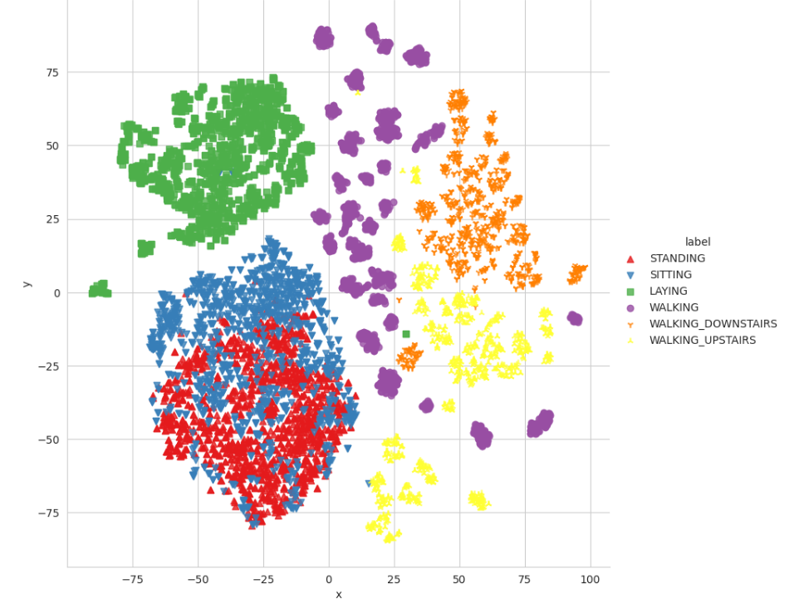
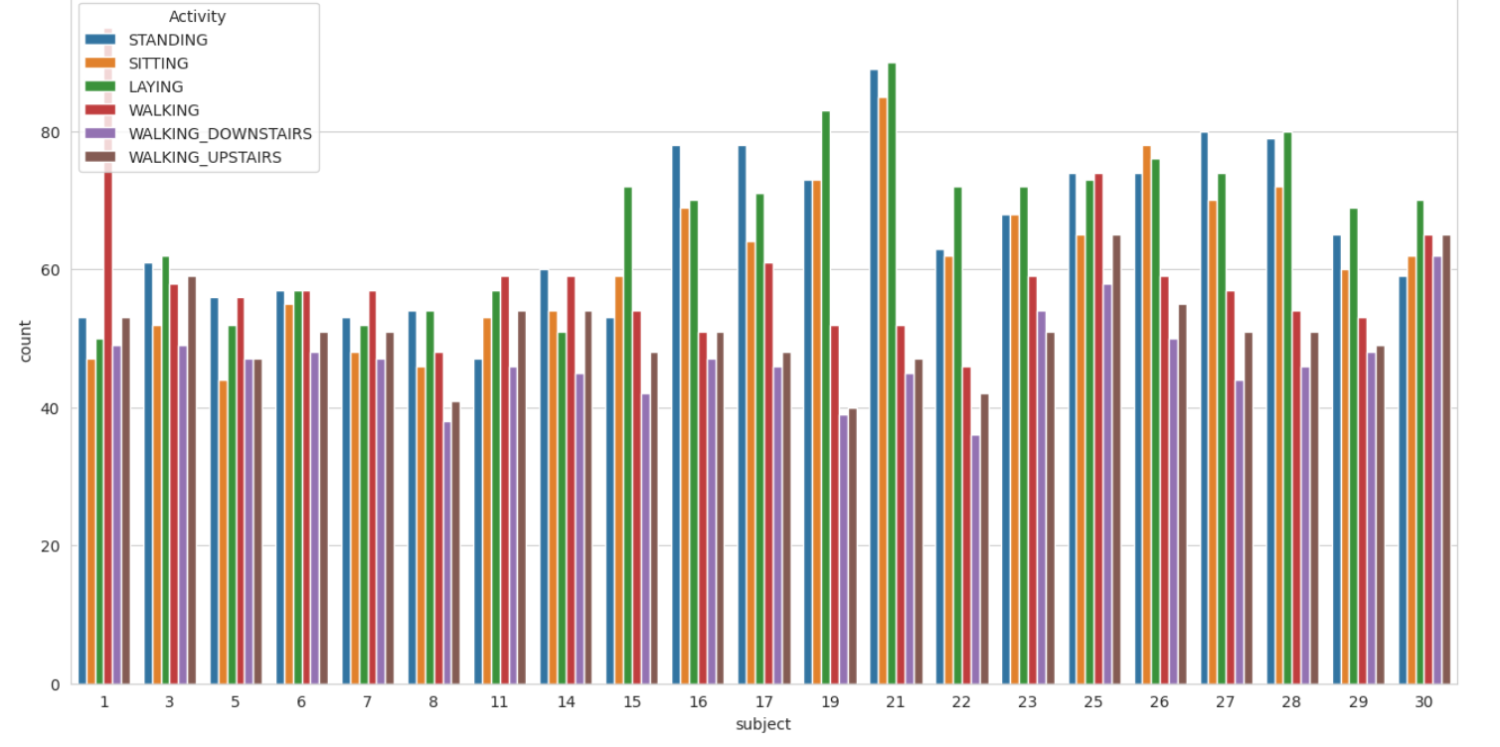
RESULTS
Static and Dynamic Activity
Final Output
Dataset gathered from Users
3/21/2024 Annual Review

Slide 11
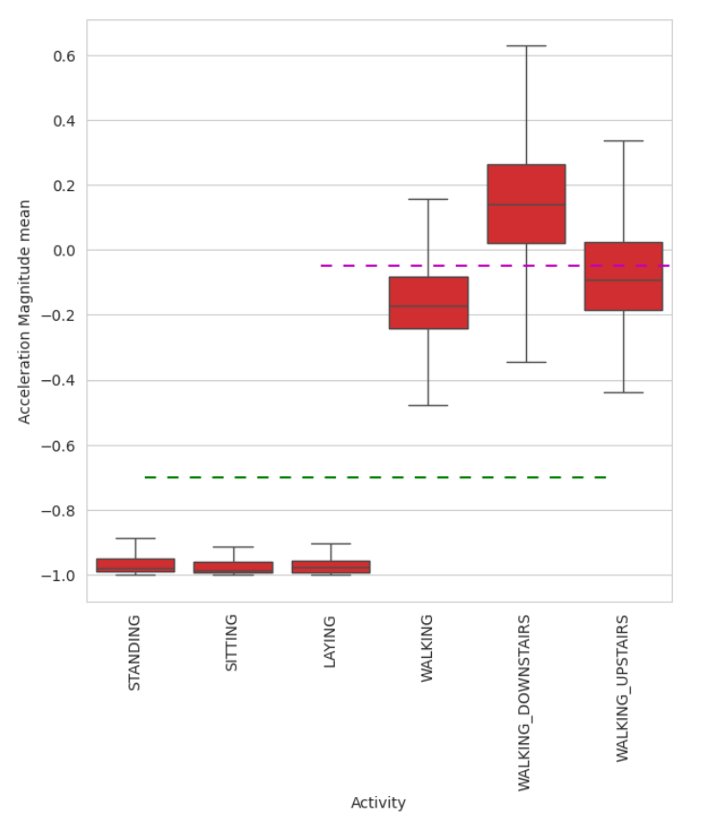
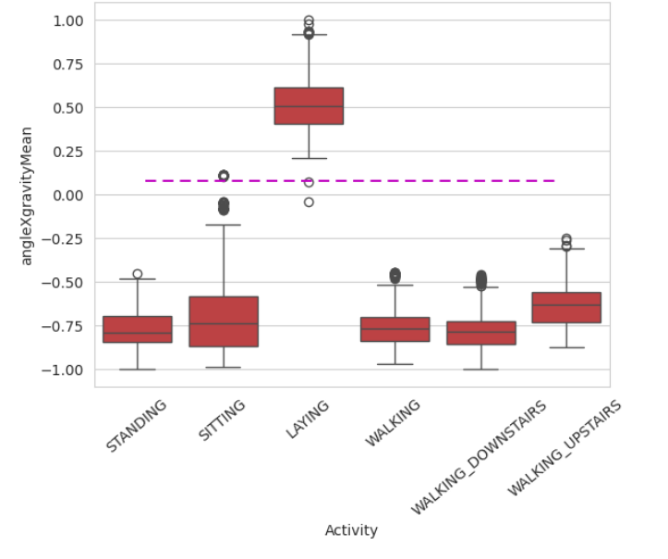
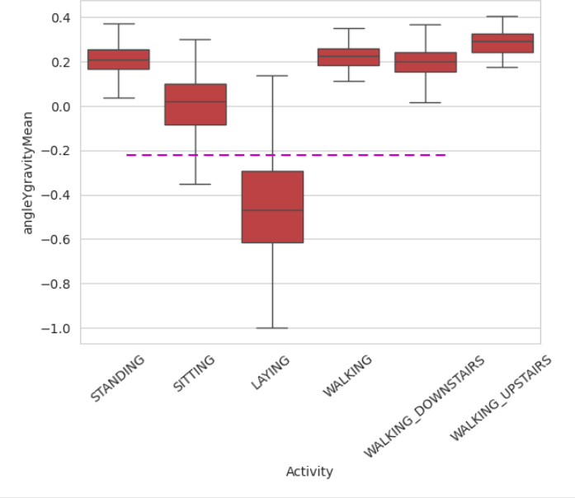
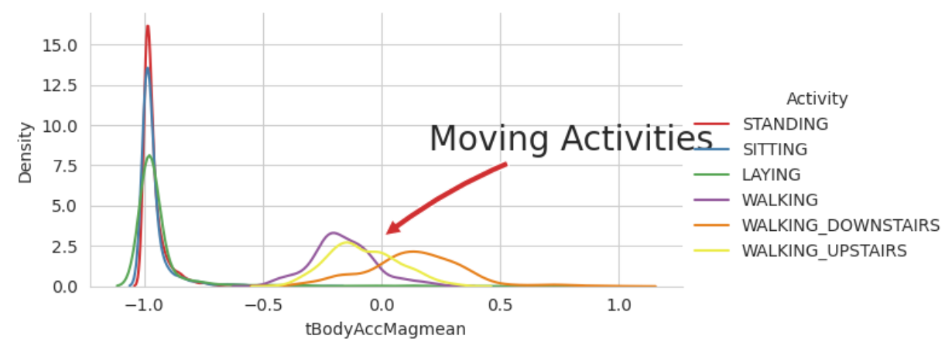
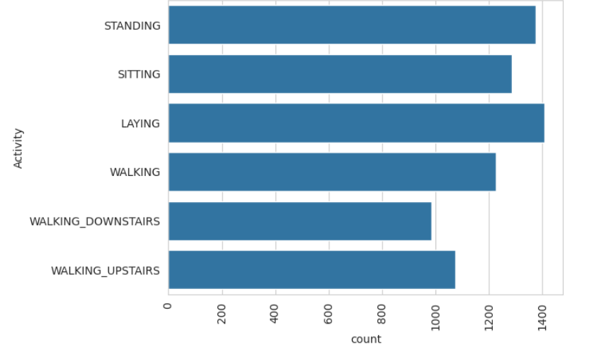
Acceleration Magnitude
Angle between X-axis
Angle between Y-axis
Movement Activity of the people
Data Points per Activity

Slide 12
Conclusion
CNNs show promise in accurately recognizing human activities from sensor or video data, offering real-time capabilities across diverse applications. Further research aims to enhance their accuracy and efficiency for improved performance in various domains.

